Slide 1
Machine Learning with Golang
Ephraim Berkovitch, Jan 2021 / ZipRecruiter

Slide 2
Accompanying Materials
https://github.com/ephraimberkovitch/golang_ml
http://www.cs.jhu.edu/~mdredze/datasets/sentiment/processed_acl.tar.gz

Slide 3
Why ML in Go
simple syntax
clearly describe complex algorithms
does not obscure developers from understand how to run efficient optimized code
easy to deploy and code
easy to understand and debug
have its performance measured

Slide 4
ML in Go vs Python
ML frameworks use languages like C/C++ for actual computation
all offer a Python interface
Cortex is an open source platform for deploying, managing, and scaling machine learning in production: Go - 80%, Python - 15%
all-in-one model-to-microservice platform
To actually run a production machine learning API at scale, infrastructure needs to
Autoscaling, so that traffic fluctuations don’t break our APIs (and our AWS stays manageable)
API management, to handle multiple deployments
Rolling updates, so that we can update models while still serving requests
Reliability - first line of defense, to avoid silly type errors - static typing, compilation step, no dead code, no unused imports
Python for data science and scripting, Go for infrastructure

Slide 5
Why ML in Go
Go is common practice in infrastructure
We are software engineers, not data scientists, by background
We wanted a simple tool that would take a trained model and automatically implement all the infra features needed—like reproducible deployments, scalable request handling, automated monitoring, etc—to deploy it as an API
Kubernetes, Docker, and Terraform use Go
It’s fast.
It handles concurrency well.
It compiles down to a single binary.
Concurrency and scheduling
Goroutines, channels, and Go’s built-in timers and tickers

Slide 6
ML Steps
Steps
Gather data
Perform exploratory data analysis
Determine the correct machine learning solution to use
Build a model
Train the model
Test the model

Slide 7
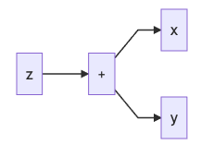
Gorgonia
Deep learning in Go
Write and evaluate math equations with multi dimensional arrays
go get gorgonia.org/gorgonia
g := gorgonia.NewGraph() // expression/computation graph
VM - understands graphs and computes it
Go Machine
Lisp Machine
Tape Machine
compile-once, run-many-times
computational graph does not change
suitable for linear regression, etc.

Slide 8
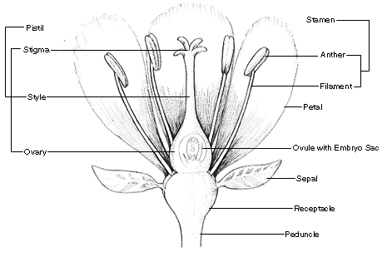
Flower species prediction by classification
https://gist.github.com/curran/a08a1080b88344b0c8a7
features - X (עלי גביע ועלי כותרת)
sepal_length
sepal_width
petal_length
petal_width
target - y
species - setosa, versicolor, virginica
Sepal: The outer parts of the flower
(often green and leaf-like) that enclose a
developing bud.
Petal: The parts of a flower that are often
conspicuously colored.

Slide 9

Flower Species Prediction

Slide 10

Linear Regression
encode the data (the true facts from observation of different flowers) into a matrix
containing 5 columns (sepal length, sepal width, petal length, petal width and 1 for the bias).
A row of the matrix represents a flower

Slide 11


Linear Regression
Encode categorical data
setosa = 1.0
virginica = 2.0
versicolor = 3.0
Other encoding techniques:
species_setosa = 1/0; species_virginica=0/1; species_versicolor=0/1
Learning phase cost:
Use gradient descent to lower the cost
* Another technique - use Gonum to get accurate Theta values:
https://gist.github.com/owulveryck/19a5ba9553ff8209b3b4227b5325041b

Slide 12
Gota - Pandas
Generate the training set with Gota
dataframe
series
Useful methods
df := dataframe.ReadCSV(f)
df.Drop("species")
xDF.Describe()
df.Mutate

Slide 13
Data Wrangling Library - gota
Counterpart of Python’s pandas
https://github.com/go-gota/gota
Load CSV
Pre-processing data
Re-name, remove columns
Filter out irrelevant data
Training / validation data
Dataframe.Subset
Encoding data with categorical values

Slide 14
Scientific and Plotting Library - gonum + gonum/plot
Counterpart of Python’s numpy
https://www.gonum.org/ - GoNum
set of packages designed to make writing numerical and scientific algorithms productive, performant, and scalable

Slide 15
Gonum - Numpy, Matplotlib
gonum.org/v1/gonum/mat - 2-dimensional matrices
gonum.org/v1/plot

Slide 16
Train in python, Serve in Go
https://github.com/galeone/tfgo

Slide 17
Jupyter Kernel for Go
gophernotes
https://github.com/gopherdata/gophernotes - backend - interpreter
alternatives - lgo (https://github.com/yunabe/lgo) - backend - official compiler, elder versions
docker run -it -p 8888:8888 -v $(pwd):/usr/share/notebooks gopherdata/gophernotes:latest-ds

Slide 18
Using pre-trained modules
TensorFlow for Go is not mature yet
https://www.tensorflow.org/install/lang_go - The TensorFlow Go API is not covered by the TensorFlow API stability guarantees
There is a Gorgonia framework, written completely in Go - low-level, like Theano, but has higher goals like Tensorflow

Slide 19
Using Python models
When to adopt a polyglot approach
Polyglot – use Python-only libraries like Keras in Python, reduce amount of code and in some cases, better performance, multi-team cooperation, leverage pre-existing models; more complex problems, deep learning, computer vision
Go-only - easier to maintain, less dependencies, less complexities in component interactions; when existing Go libraries offer what you need

Slide 20
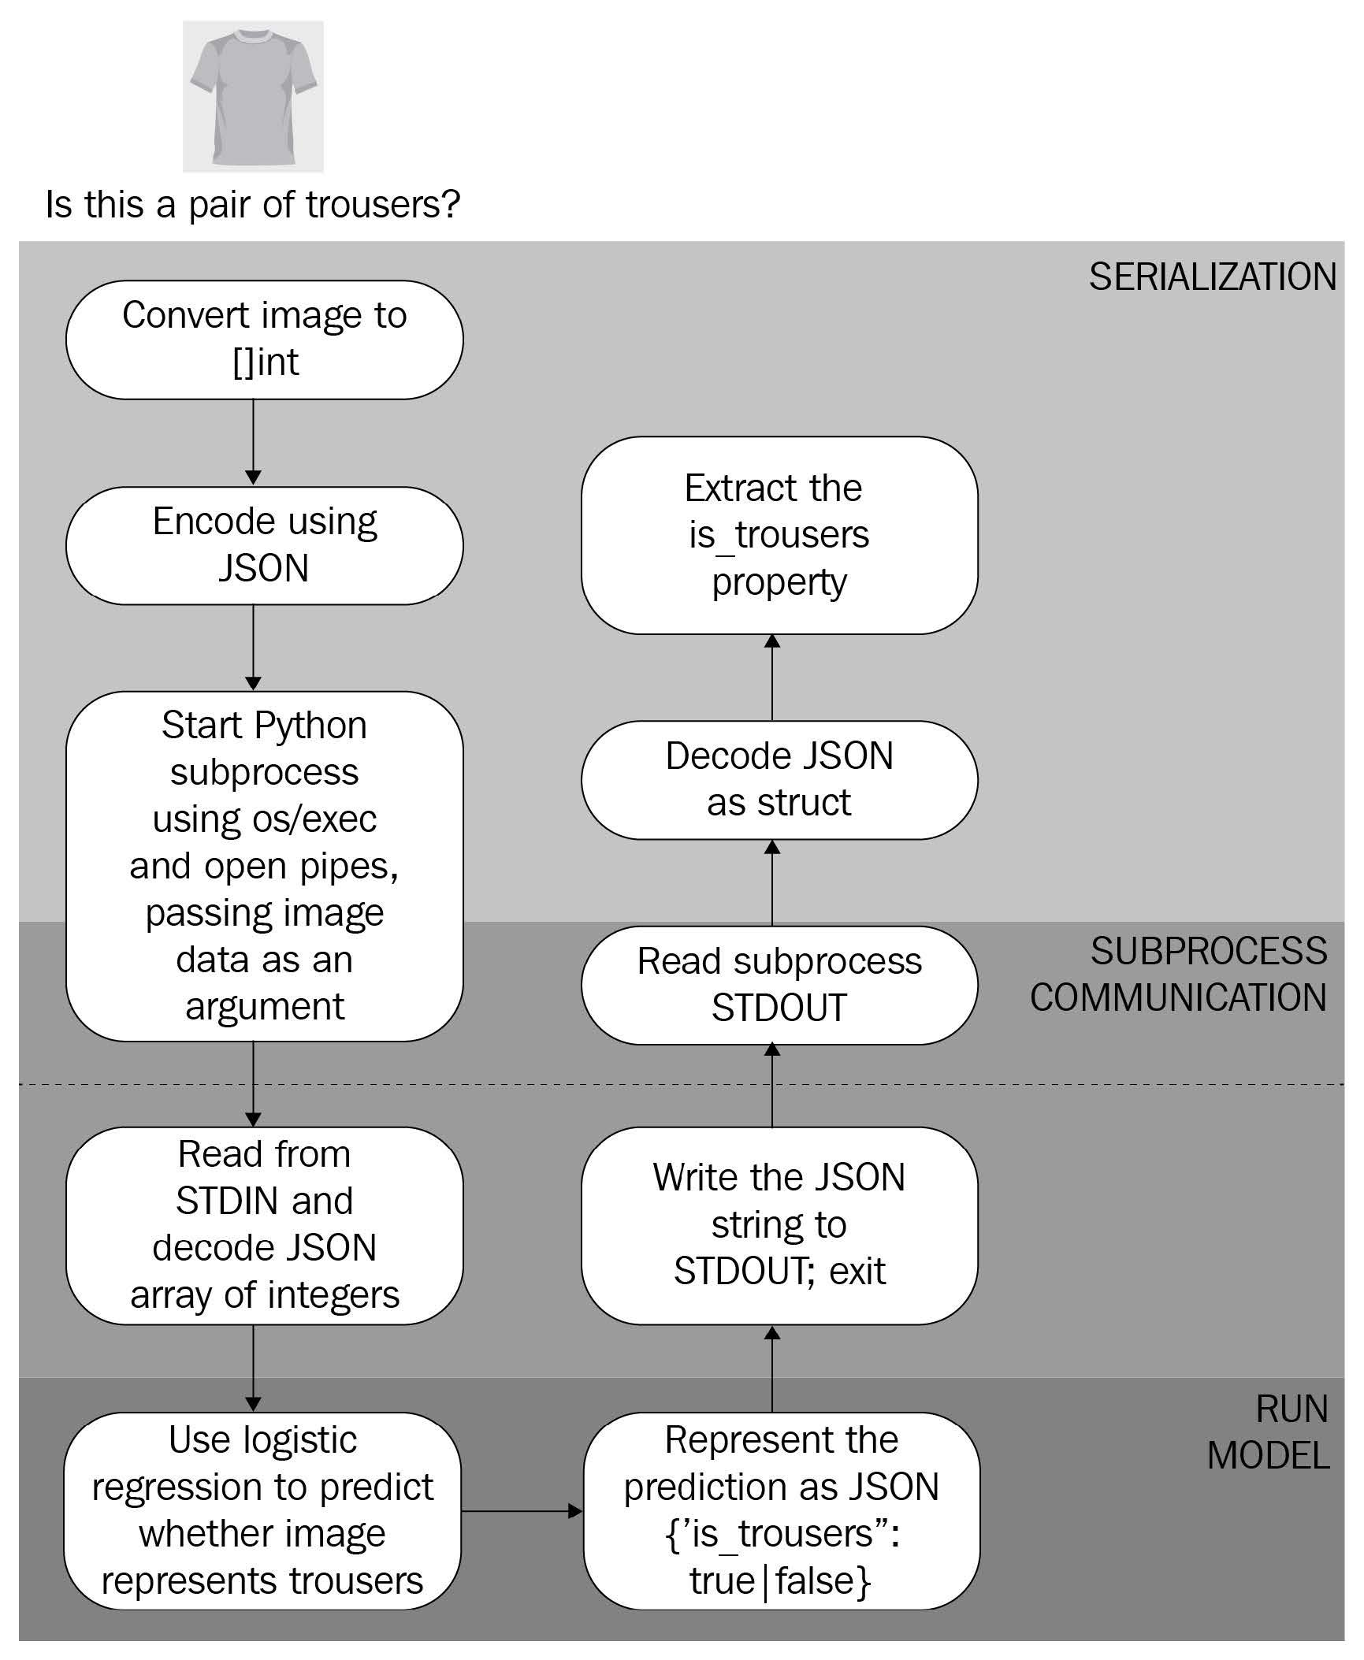
Invoke Python model using os/exec
Model is on the same machine
use command-line arguments to pass inputs to the model and read the model's prediction from standard output (STDOUT)
JSON for data exchange
Load dataset to dataframe
stdout, err := cmd.StdoutPipe()
b, err = InvokeAndWait("model.py", "predict", string(b))
Cons – start a new Python process to handle every
request, coupling with Python
Pros – small effort

Slide 21
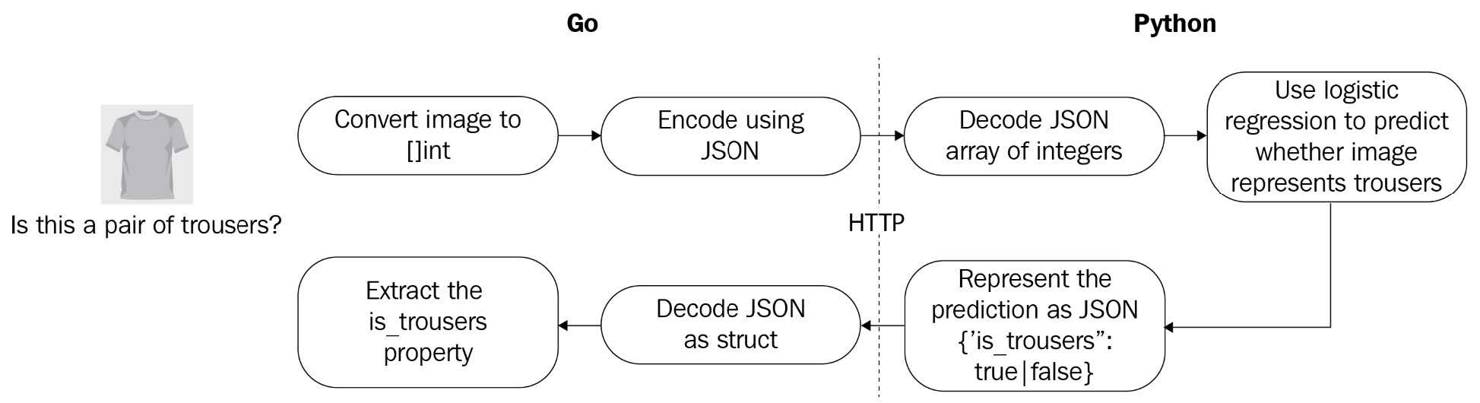
Invoke Python models using HTTP
Model is running as a service on different machine

Slide 22
Go bindings of TensorFlow
Install TensorFlow as a docker
Import pre-trained TensorFlow model
savedModel, err := tf.LoadSavedModel("./saved_model", []string{"serve"}, nil)
if err != nil {
log.Fatalf("failed to load model: %v", err)
}

Slide 23
References
Michael Bironneau, Toby Coleman, Machine Learning with Go Quick Start Guide, Packt Publishing, 2019
Xuanyi Chew, Go Machine Learning Projects, Packtpub, 2018 (https://github.com/PacktPublishing/Go-Machine-Learning-Projects)
https://tech.travelaudience.com/training-tensorflow-models-in-python-and-serving-with-go-1b2a9386b0ff
https://towardsdatascience.com/a-gentle-journey-from-linear-regression-to-neural-networks-68881590760e
https://towardsdatascience.com/why-we-deploy-machine-learning-models-with-go-not-python-a4e35ec16deb
https://github.com/gorgonia/gorgonia
https://github.com/jdkato/prose

